Slide 1
Supervised classification
-Supervised classification is the procedure for quantitative analysis of remote sensing image data
-Requires training data: Decide the set of ground cover types into which the image is to be segmented.
-Training sets for each class can be established using site visits, maps, air photographs or even photointerpretation of a colour composite product formed from the image data
-The computer uses an algorithm to determine spectral signatures for each training class and then compares each pixel in the image to these signatures and labels it as the class it most closely resembles digitally.
-Important for understanding spatial and temporal dynamics of environment.

Slide 2
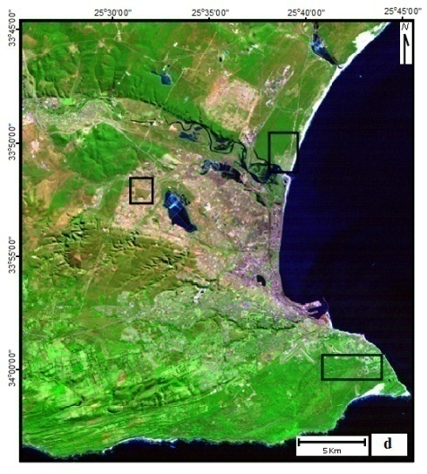
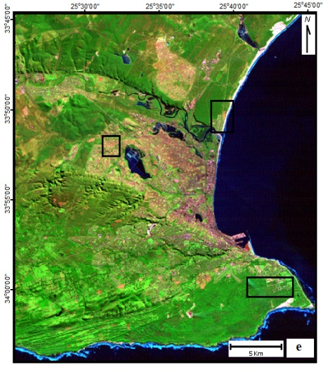
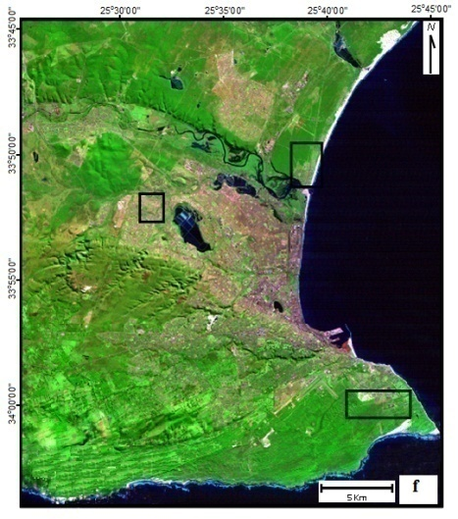
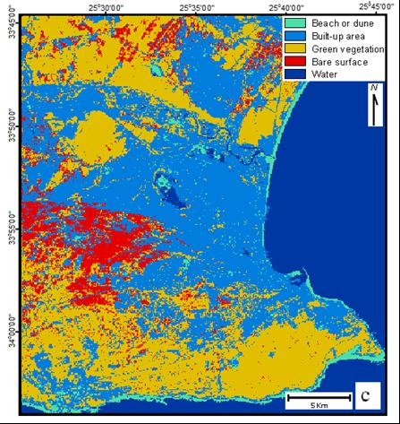

Slide 3
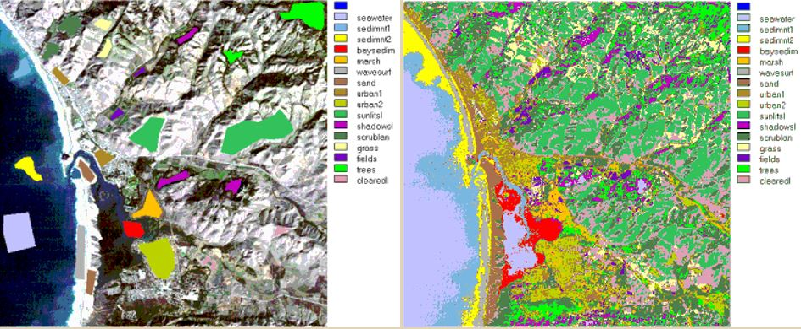

Slide 4
Advantages & Disadvantages of Supervised Classification
Disadvantages
Classes are “imposed” on the data, these may not match natural classes
Training data not often defined spectrally e.g. forest area very varied
Training areas MUST be selected carefully - time-consuming & expensive
Not all spectral classes may be known to the analyst
Advantages
-Control of categories designed for a specific purpose or classification scheme and geographic region
-Tied to areas of known identity (training areas)

Slide 5
Data partitioning
-Training data (calibration).
-Testing data (validation).
-Generally, 70% of total data is used for model training.
-And 30% used for model performance evaluation.
-Classification accuracy vary with algorithm adopted and image type used.

Slide 6
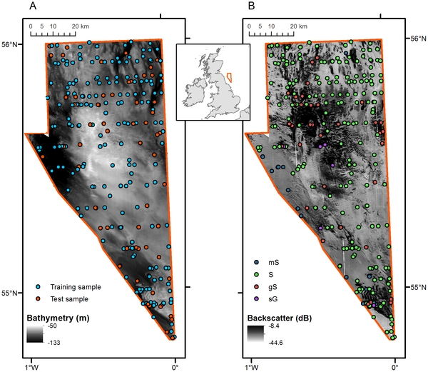

Slide 7
Statistical Algorithms
-A statistical modeling algorithm is a model-based learning algorithm that uses a statistical model to analysis input data.
-It can range from being a Parametric Statistical Modeling Algorithm to being a Nonparametric Statistical Modeling Algorithm.
-Data analysis can be based on traditional classification or regression approach.

Slide 8
Classification algorithms
Parametric algorithms
Parametric algorithms are based on a mathematical model that defines the relationship between inputs and outputs.
There are faster and easier to train.
There are most appropriate for problems where the input data is well-defined and predictable.
Examples: Maximum Likelihood, Parallel pipe etc.
Nonparametric algorithms
Nonparametric algorithms are not based on a mathematical model; instead, they learn from the data itself.
There are flexible than parametric algorithms but also more computationally expensive.
There are most appropriate for problems where the input data is not well-defined or is too complex to be modelled using a parametric algorithm.
Examples: Random Forest, Support Vector Machine etc.

Slide 9
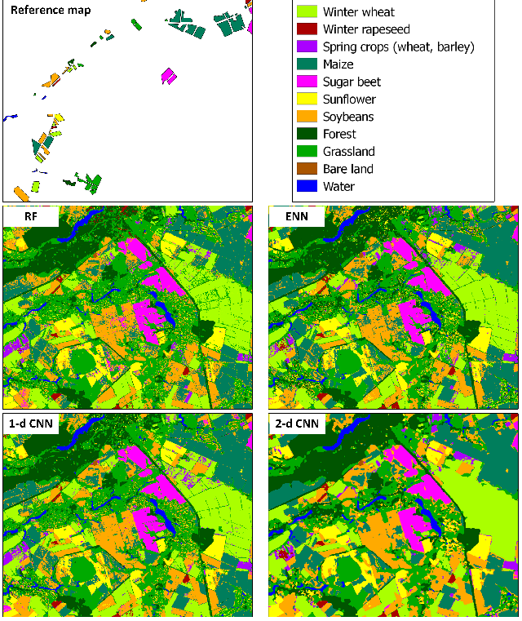

Slide 10
